Slide 1
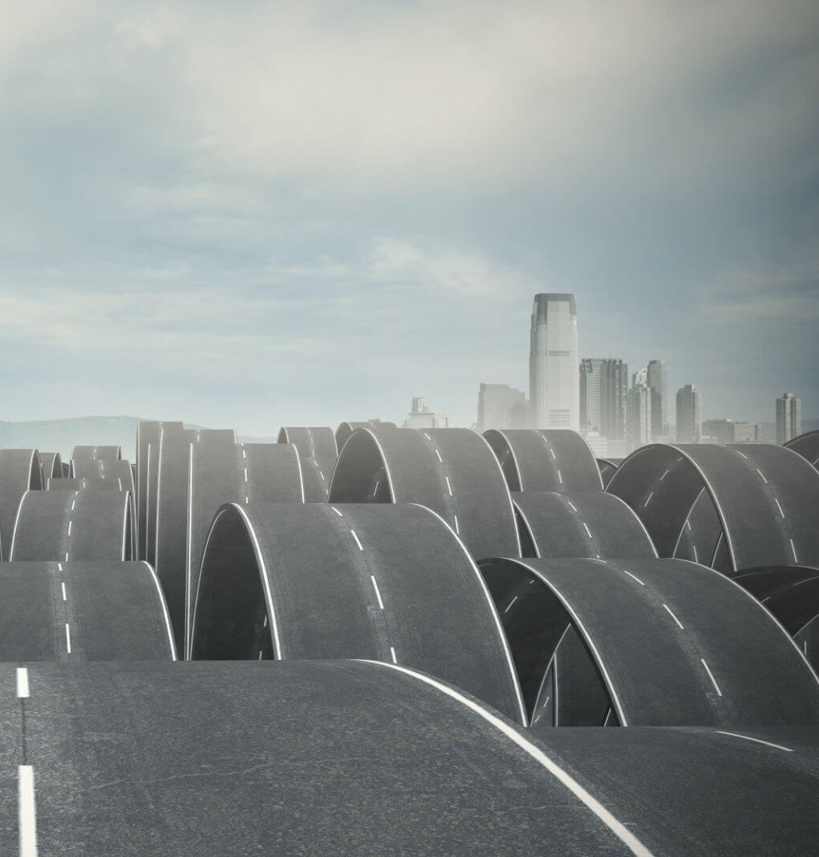

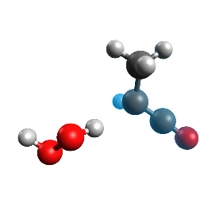
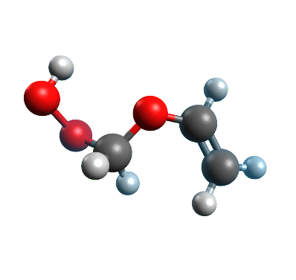
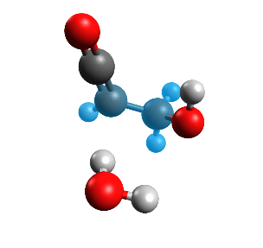
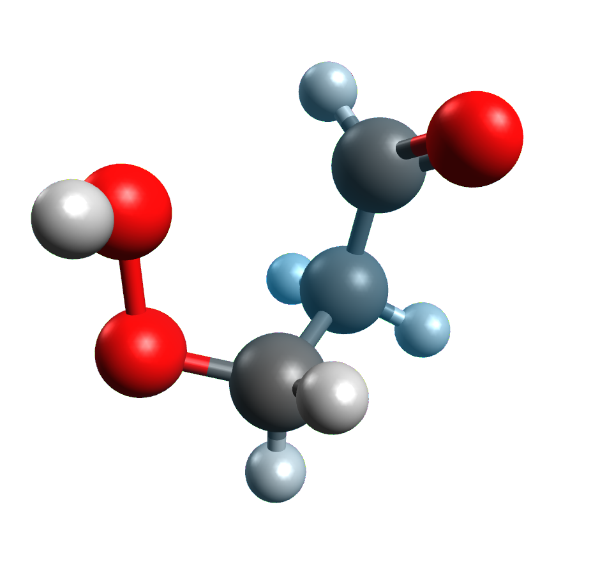
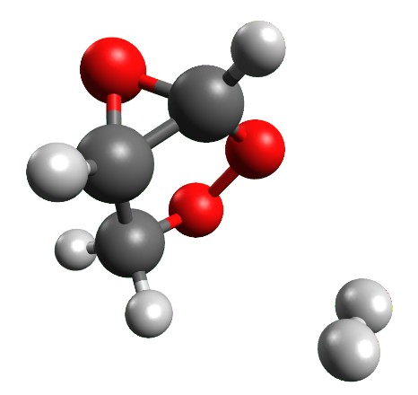
Automated Discovery of
Important Chemical Reactions
Colin Grambow
ExxonMobil Seminar
31 October 2019

Slide 2
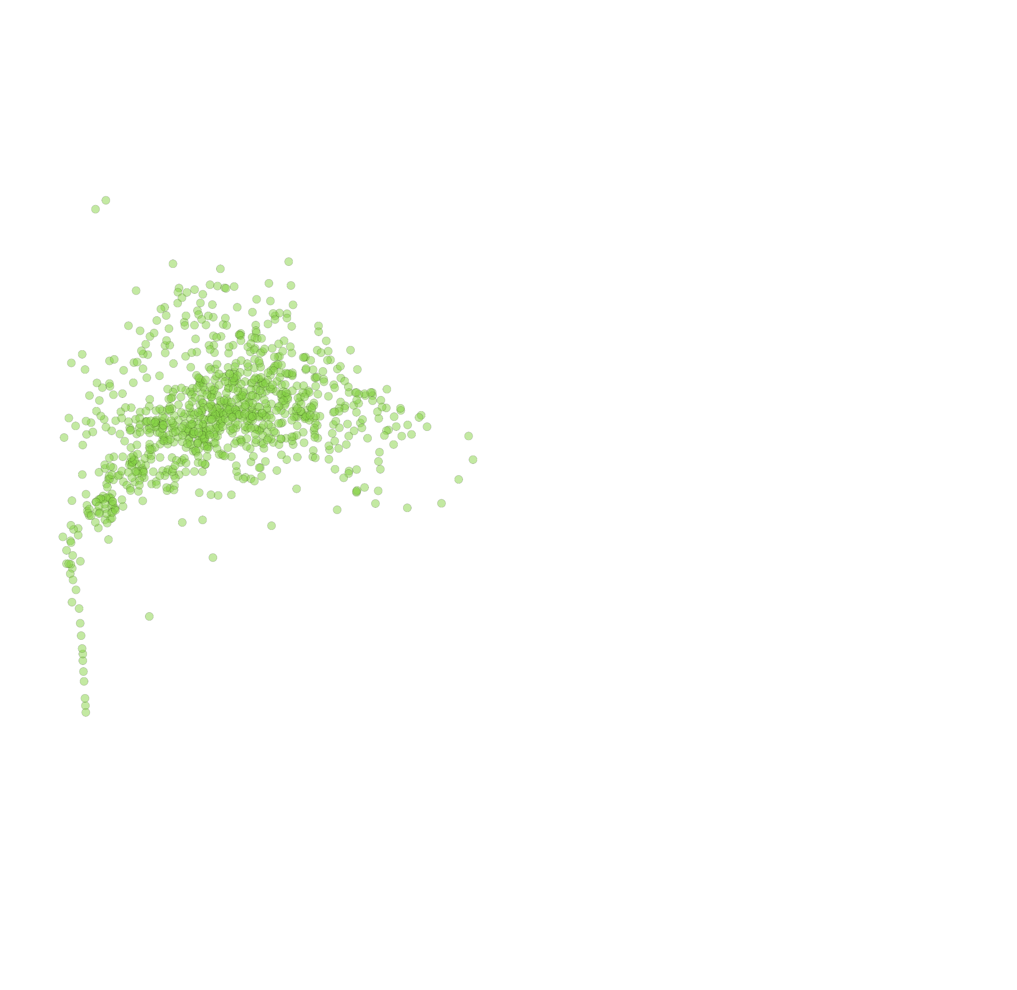
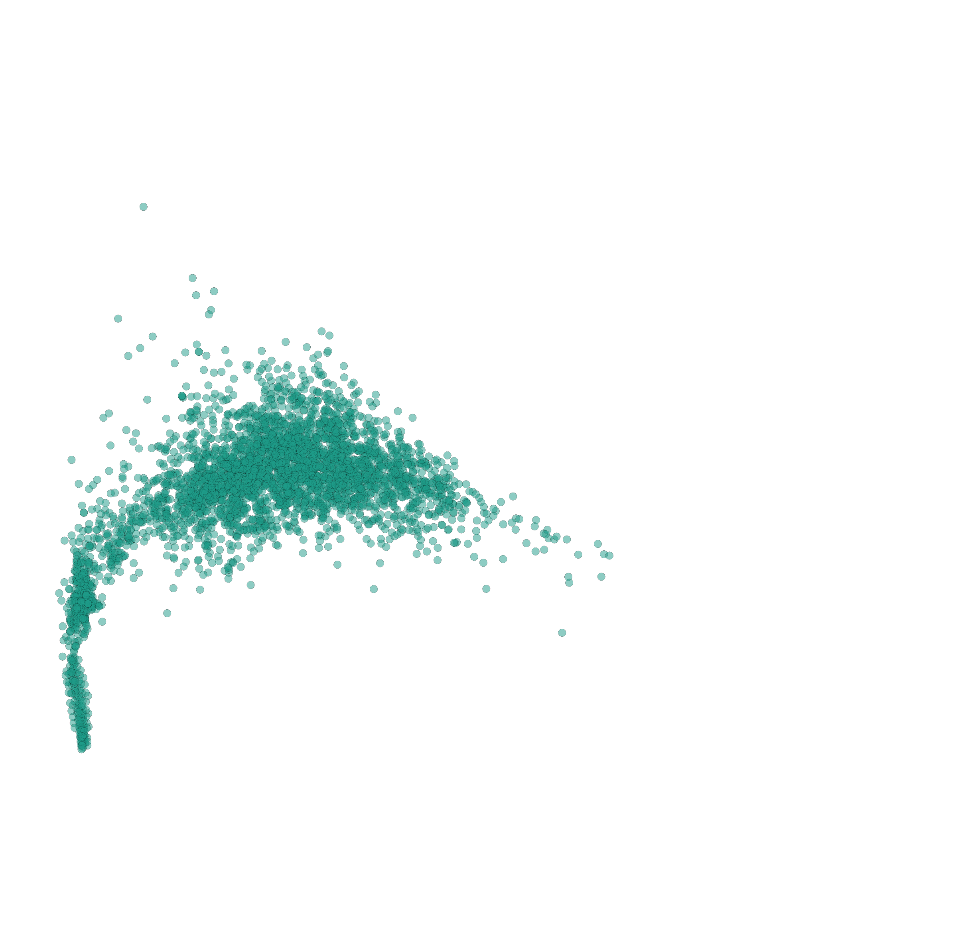
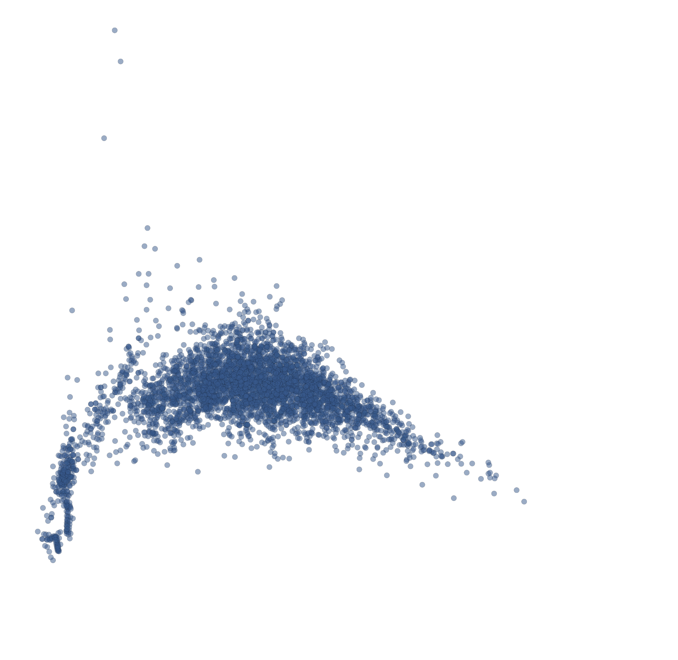


Unexplored chemical space awaits discovery
Unexplored chemical space
Largest proprietary databases:
~10²⁰ enumerable molecules
$$≪$$
Known region of chemical space
Total chemical space: ~10⁶⁰ molecules

Slide 3
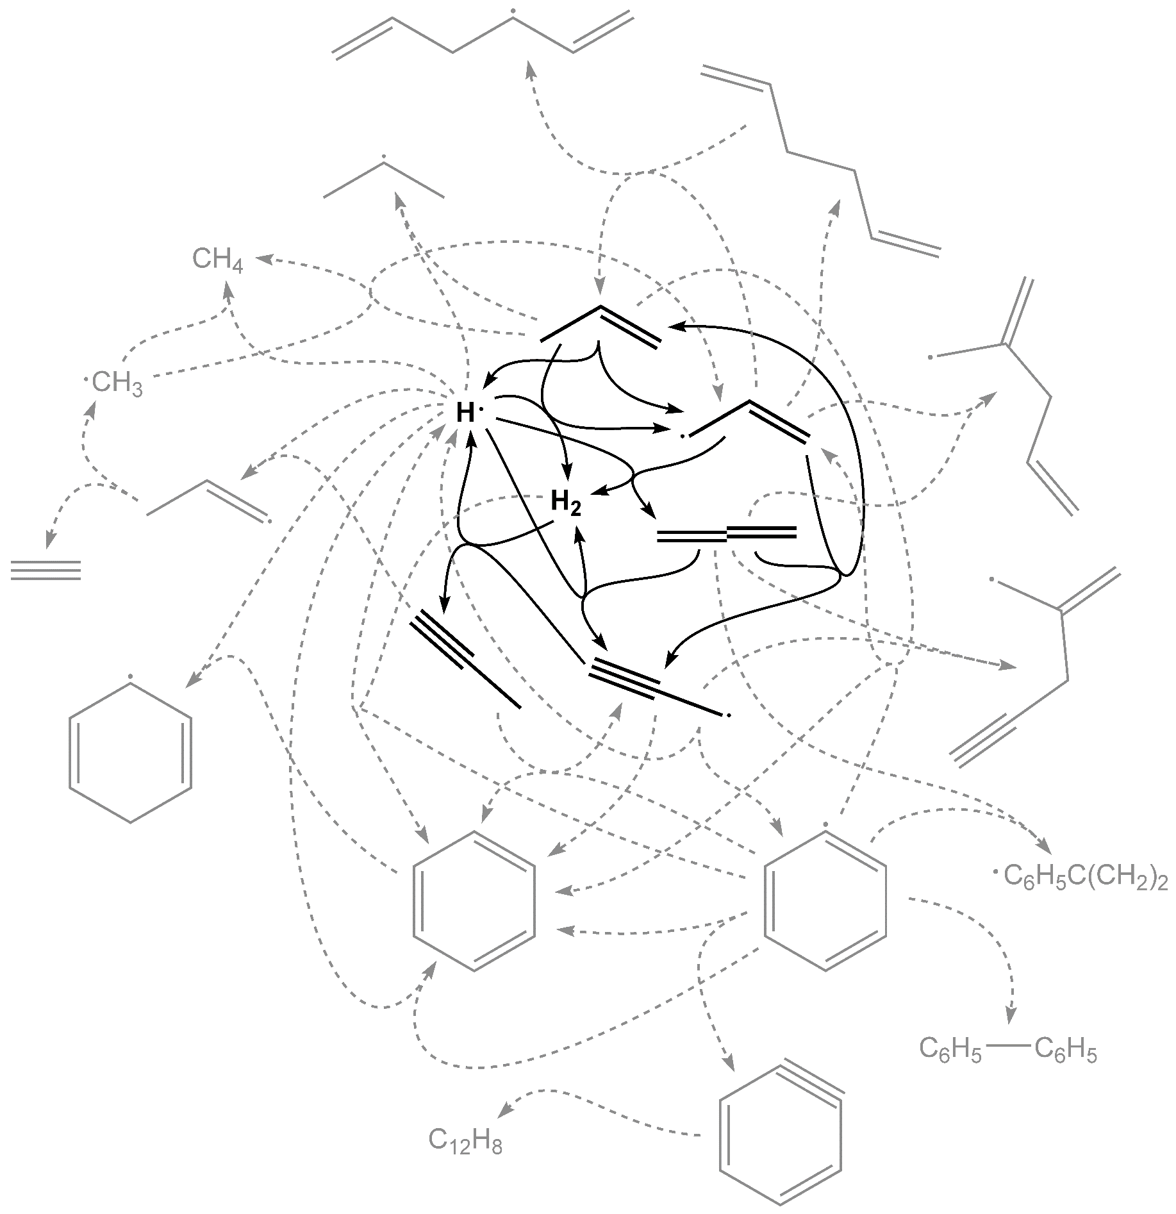
Discovering new chemistry is useful in many situations
Automated reaction mechanism generation
Organic synthesis planning

Slide 4
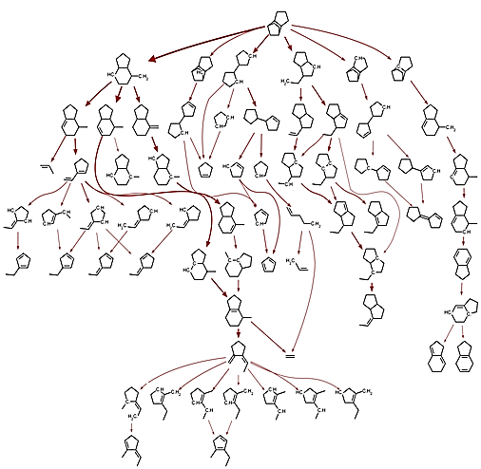


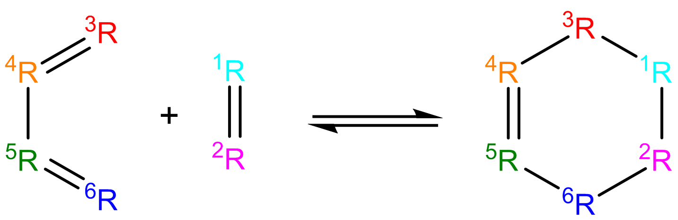
Reaction mechanisms can be generated computationally
Reaction templates & kinetics estimation

Slide 5

Mechanisms are often missing important reactions
Missing reaction
pathway

Slide 6
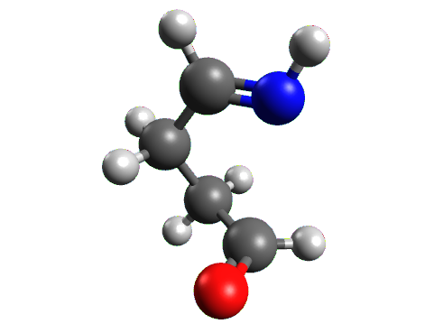
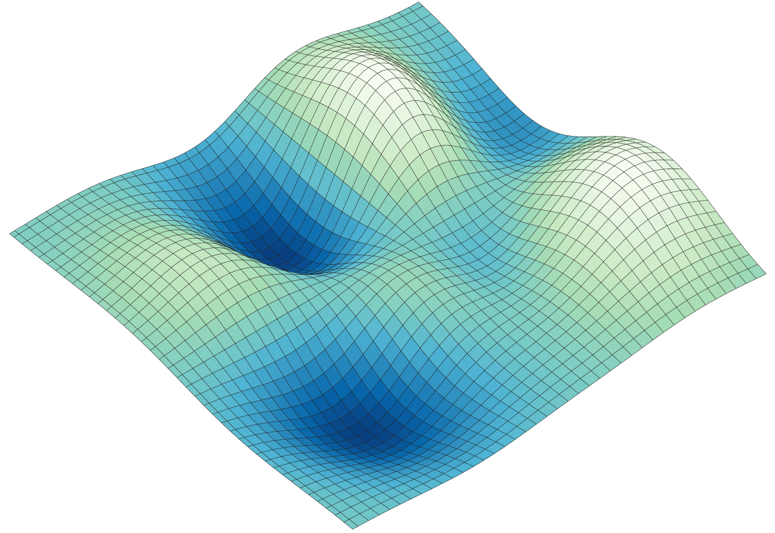
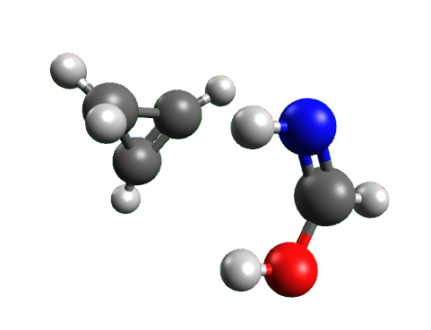
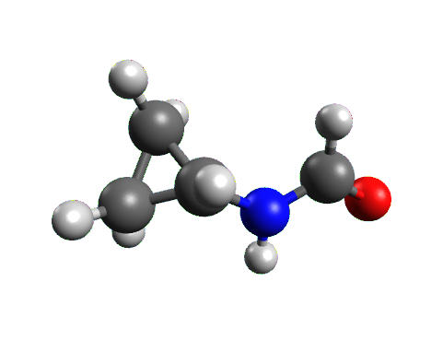
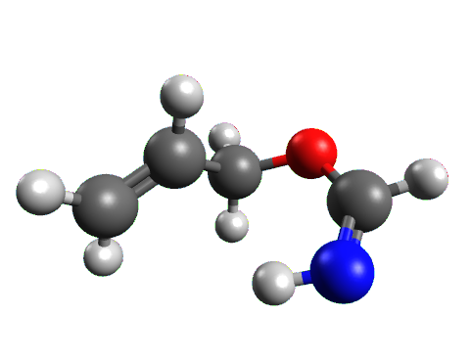
Goals
Develop efficient and quantitative methods to explore chemical space
Provide methods for improving reaction mechanisms
?
?
?

Slide 7


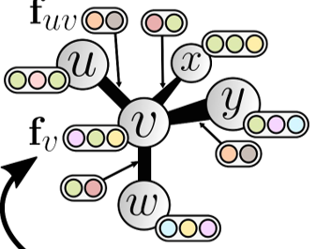
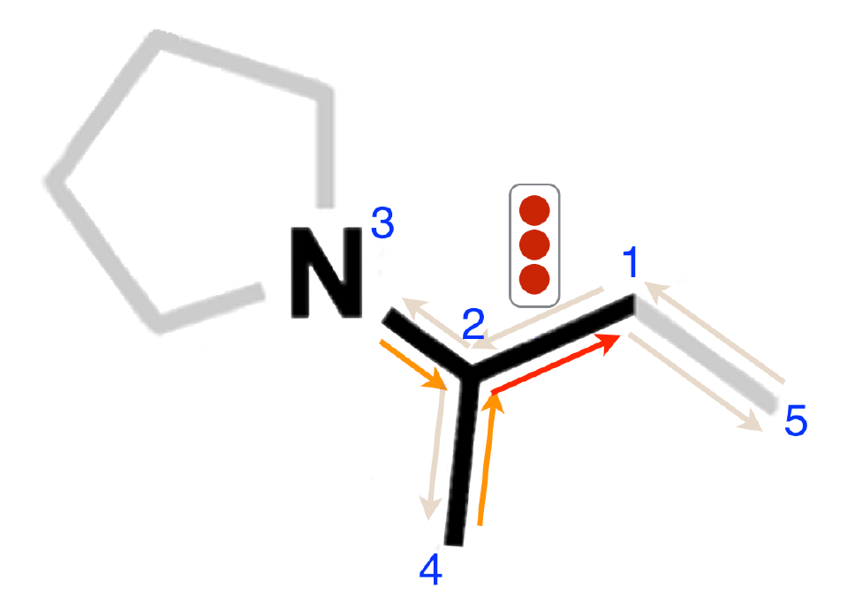
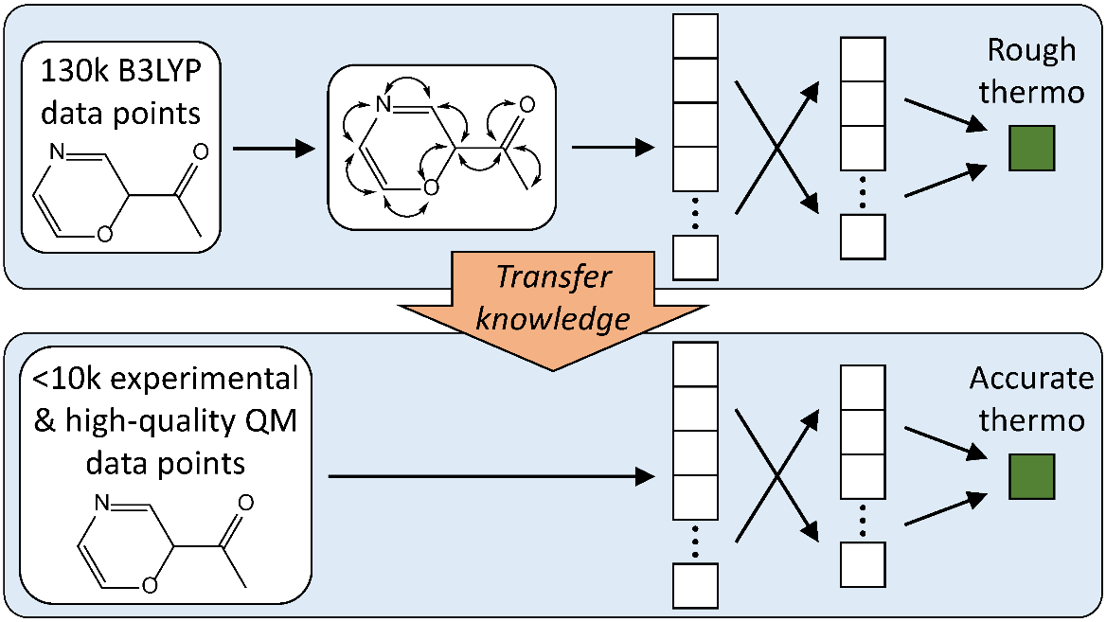
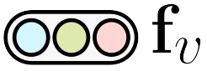


Overview
Background
Automated transition state algorithms
Improved thermochemistry estimation
Scalability of automated reaction discovery
?
4
3
8
5
6
2
1
9
7
8
1
2
3
4
5
7
9
6
?
?
NN
NN

Slide 8
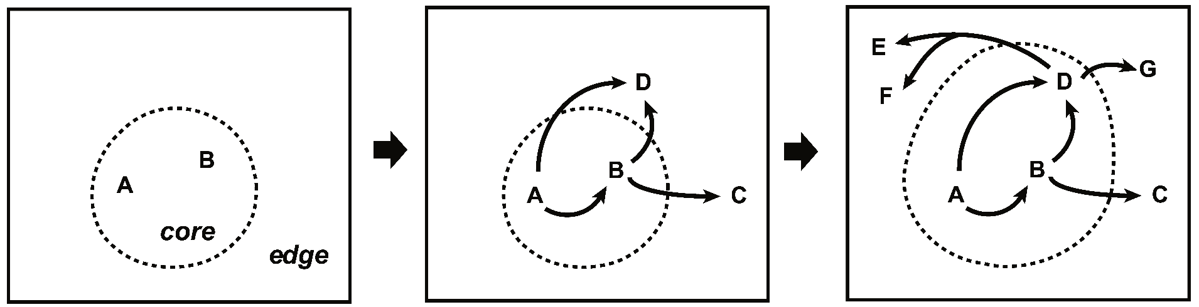

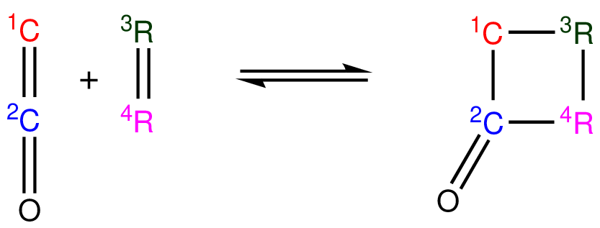
Reaction Mechanism Generator creates chemical mechanisms using a rate-based algorithm
Simulation Input
Initial core species
Initial conditions
Termination Criteria
RMG
1. Determine all possible reactions between core species
2. Integrate in time
3. Add high flux species to core
Using reaction templates/families

Slide 9
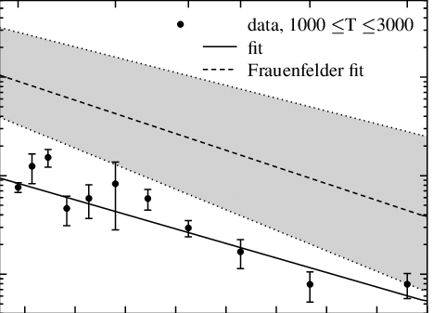
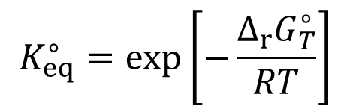
RMG’s chemistry knowledge is incomplete and rate estimates can be inaccurate
Estimate
Experiment
Also require good thermochemistry
$$K_{eq}^{∘}=\exp\left[−\frac{Δ_{r}G_{T}^{∘}}{RT}\right]$$
Missing templates
Inaccurate estimates

Slide 10
Computing potential energy surfaces enables quantitative evaluation of thermochemistry and kinetics at large cost
Minima
Saddle points
Thermochemistry
Reactions and kinetics

Slide 11
Overview
Background
Automated transition state algorithms
Improved thermochemistry estimation
Scalability of automated reaction discovery
?
4
3
8
5
6
2
1
9
7
8
1
2
3
4
5
7
9
6
?
?
NN
NN

Slide 12
Comprehensive and quantitative potential energy surface exploration is desirable
All pathways
Accurate energies

Slide 13
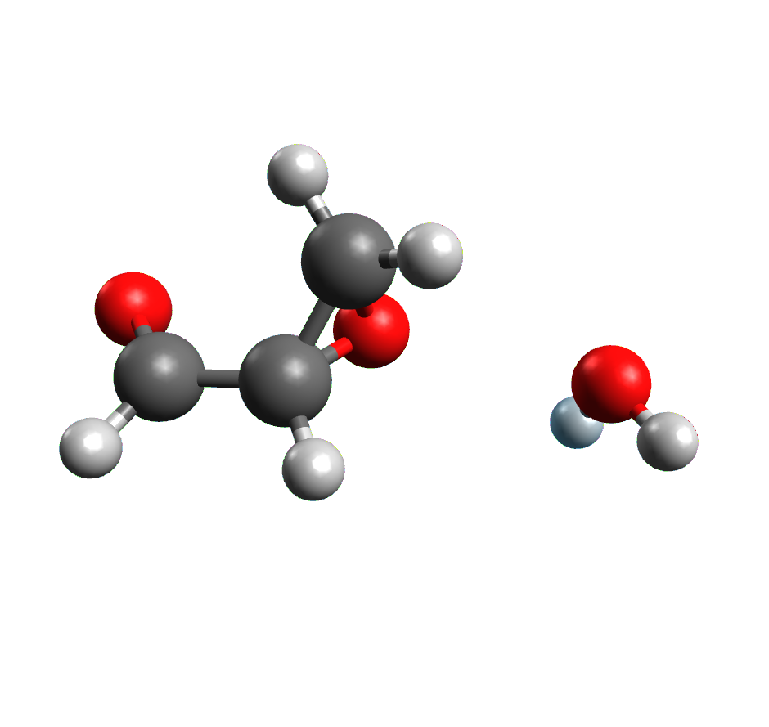
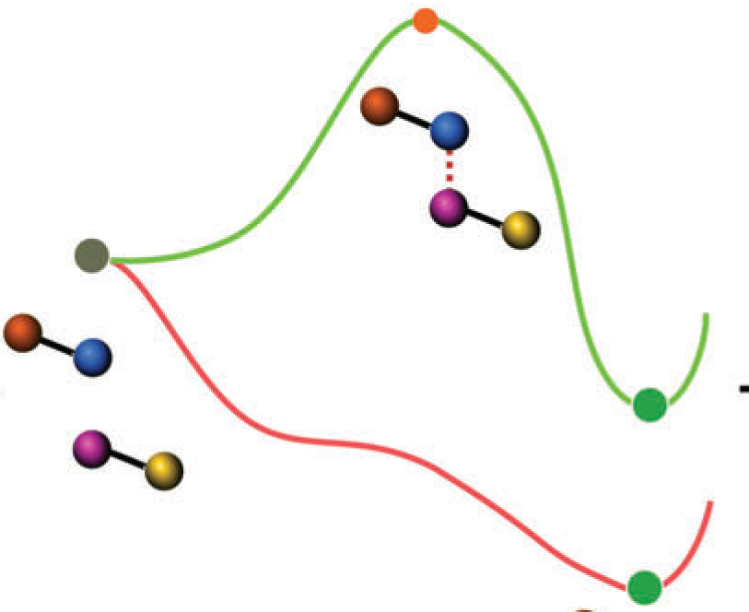
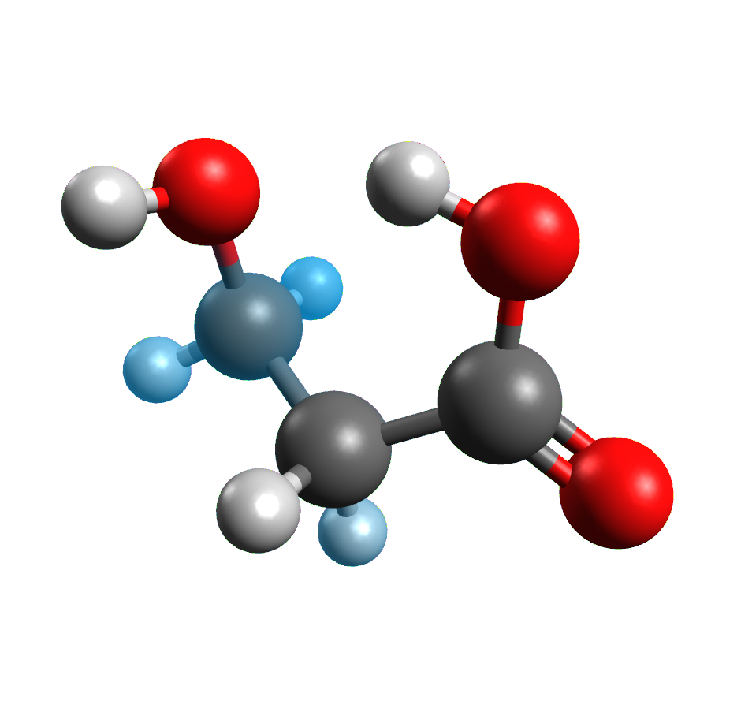
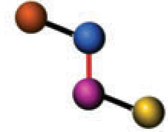
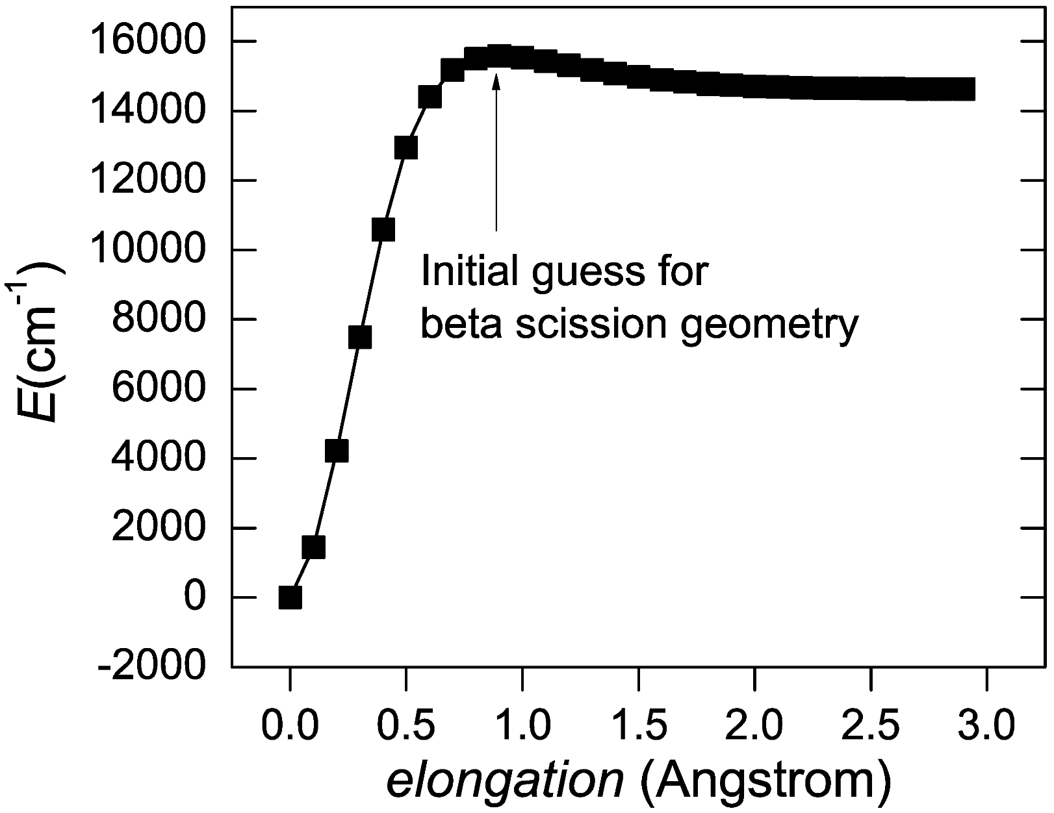
Many different automated transition state finding algorithms were evaluated
Generate TS guesses directly
Generate intermediates
Path w/o force
Path w/ force
…
Generate driving coordinates
BREAK 3 4
BREAK 1 9
ADD 6 9
Energy
Guess
BREAK 5 6
BREAK 3 4
BREAK 3 4
ADD 2 4
ADD 3 5
…
Bond elongation

Slide 14
Driving coordinates can be generated to find elementary reactions directly
Single-ended TS searches
SE-GSM
(single-ended growing
string method)
Generate driving coordinates
Grow and optimize paths
N_{BREAK} ≤ 3
N_{ADD} ≤ 3
…
Initial search direction

Slide 15
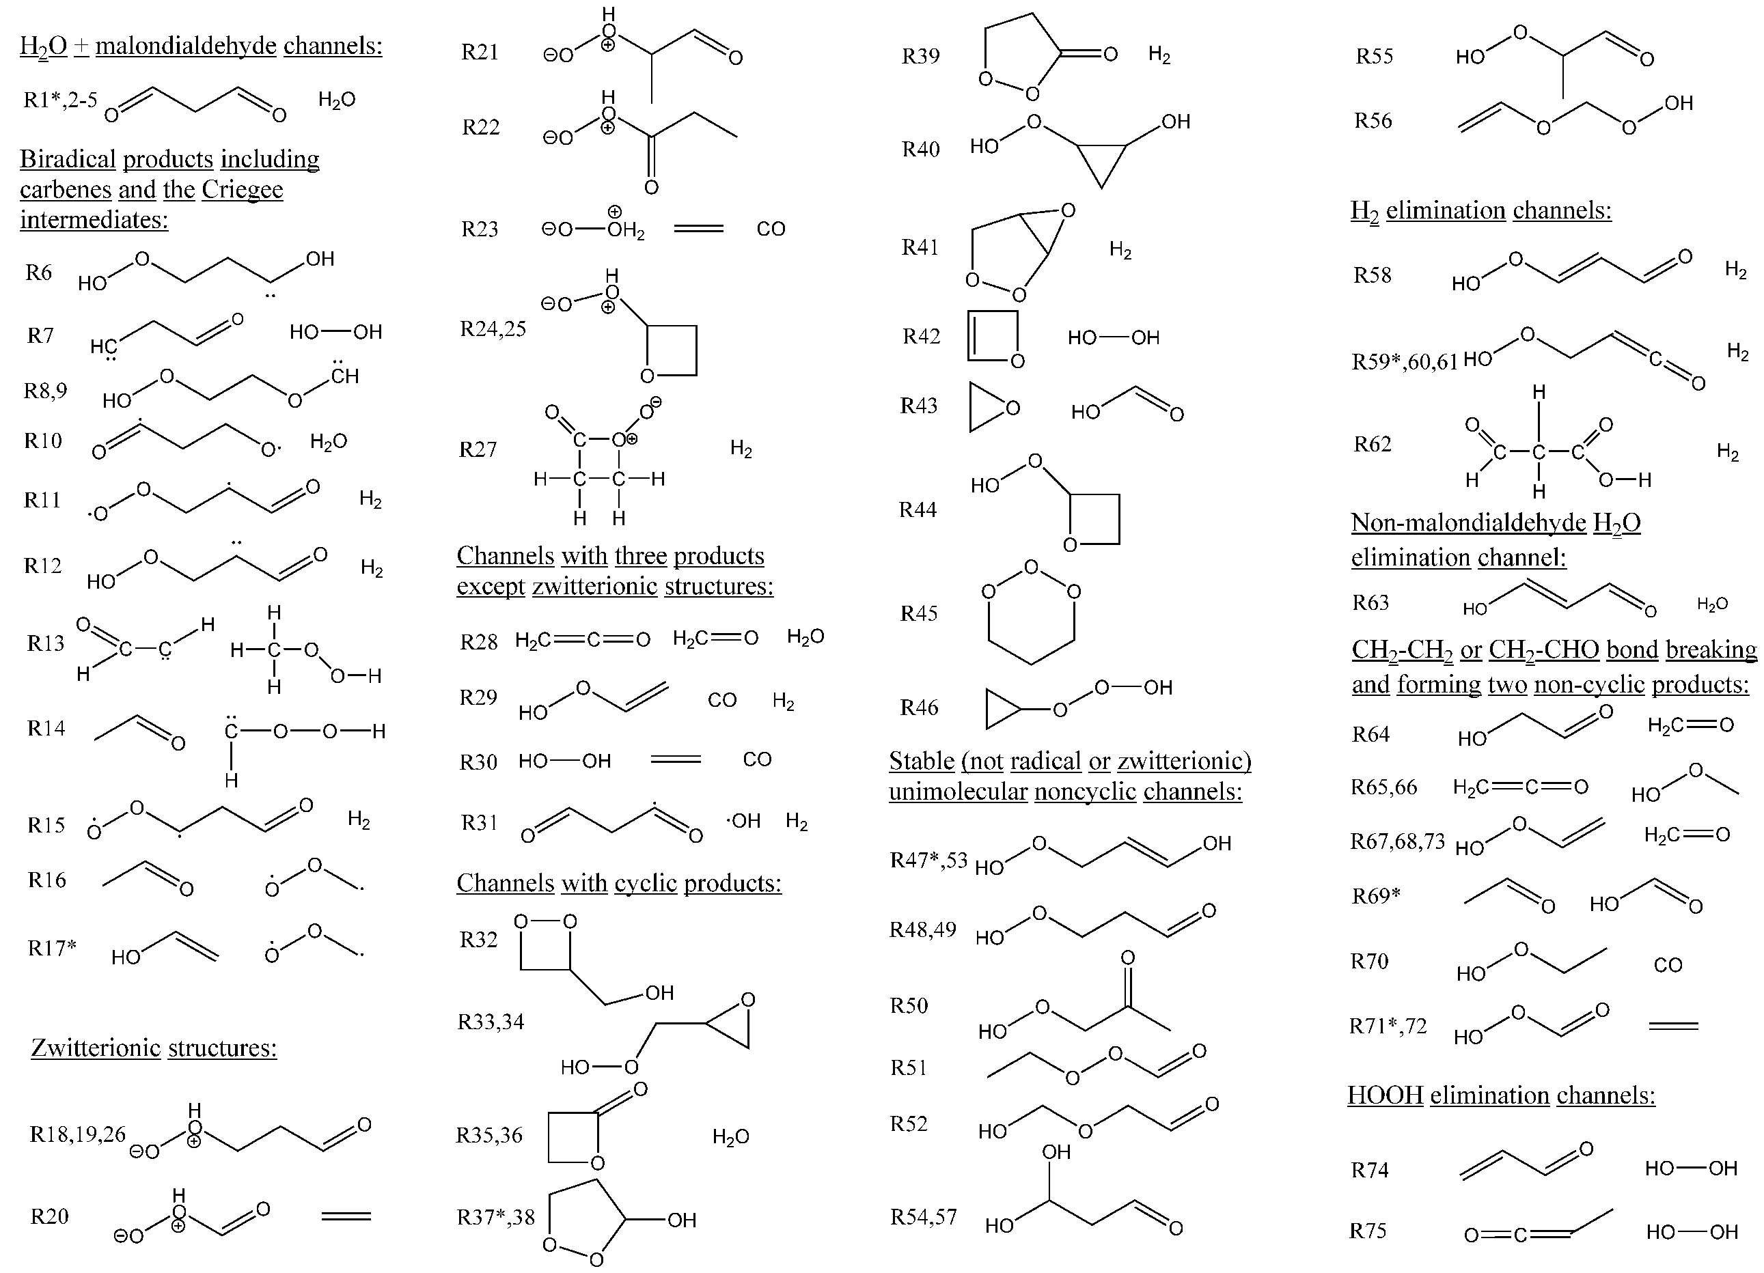
Comprehensive discovery of reaction pathways is possible using an ensemble of transition state finding methods
Ensemble of 5 different algorithms
75 unique elementary reactions
Method | Unique reactions
Freezing string | 39
Growing string | 46
Single-ended growing string | 50
Artificial force induced reaction | 7
KinBot | 48

Slide 16
Overview
Background
Automated transition state algorithms
Improved thermochemistry estimation
Scalability of automated reaction discovery
?
4
3
8
5
6
2
1
9
7
8
1
2
3
4
5
7
9
6
?
?
NN
NN

Slide 17
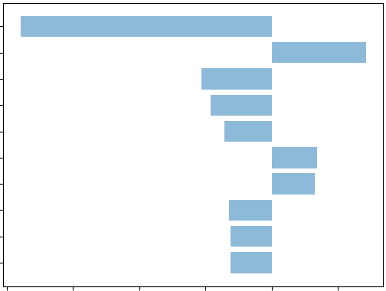
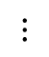
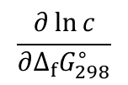
Group additivity and manual QM refinement are insufficient
Group additivity
14.9 kcal/mol
Error:
105 kcal/mol
29.0 kcal/mol
Species A
refine with QM
Species B
Species C
Machine learning estimator
$$⋮$$
Slow and laborious
“Instantaneous”
thermochemistry predictions
Sensitivity
$$\frac{∂\ln{c}}{∂Δ_{f}G_{298}^{∘}}$$

Slide 18
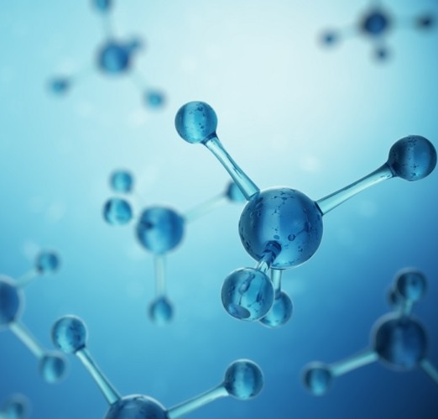
Molecules can be encoded using graph convolutional neural networks
0 | 0 | 0 | 0 | 0 | 0 | 0
0 | 2 | 0 | 0 | 1 | 0 | 0
0 | 0 | 2 | 2 | 0 | 1 | 0
0 | 0 | 0 | 2 | 2 | 2 | 0
0 | 2 | 0 | 2 | 2 | 2 | 0
0 | 1 | 1 | 1 | 2 | 0 | 0
0 | 0 | 0 | 0 | 0 | 0 | 0
1 | 0 | 0
0 | 1 | 0
0 | 0 | 1
4 | 2 | 0 | 2 | 0
0 | 6 | 4 | 2 | 2
0 | 2 | 6 | 6 | 2
3 | 1 | 4 | 4 | 4
1 | 3 | 1 | 4 | 2
Image convolution
Learnable filter
Input image
/graph
Output
Graph convolution

Slide 19
Transfer learning enables learning from little data
Base Model
Fingerprint
Hidden
Layer
Output
Graph Convolution
>100,000 DFT Data
Use Learned
Embedding
Initialize
Parameters
~10,000 High-Quality Data (expt + QM)
Transfer Learning Model

Slide 20
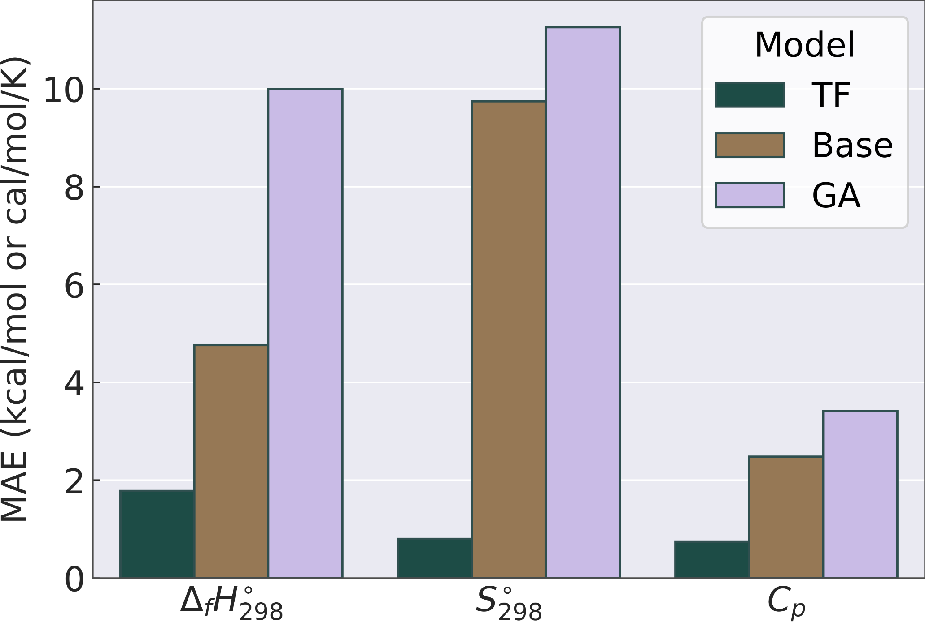
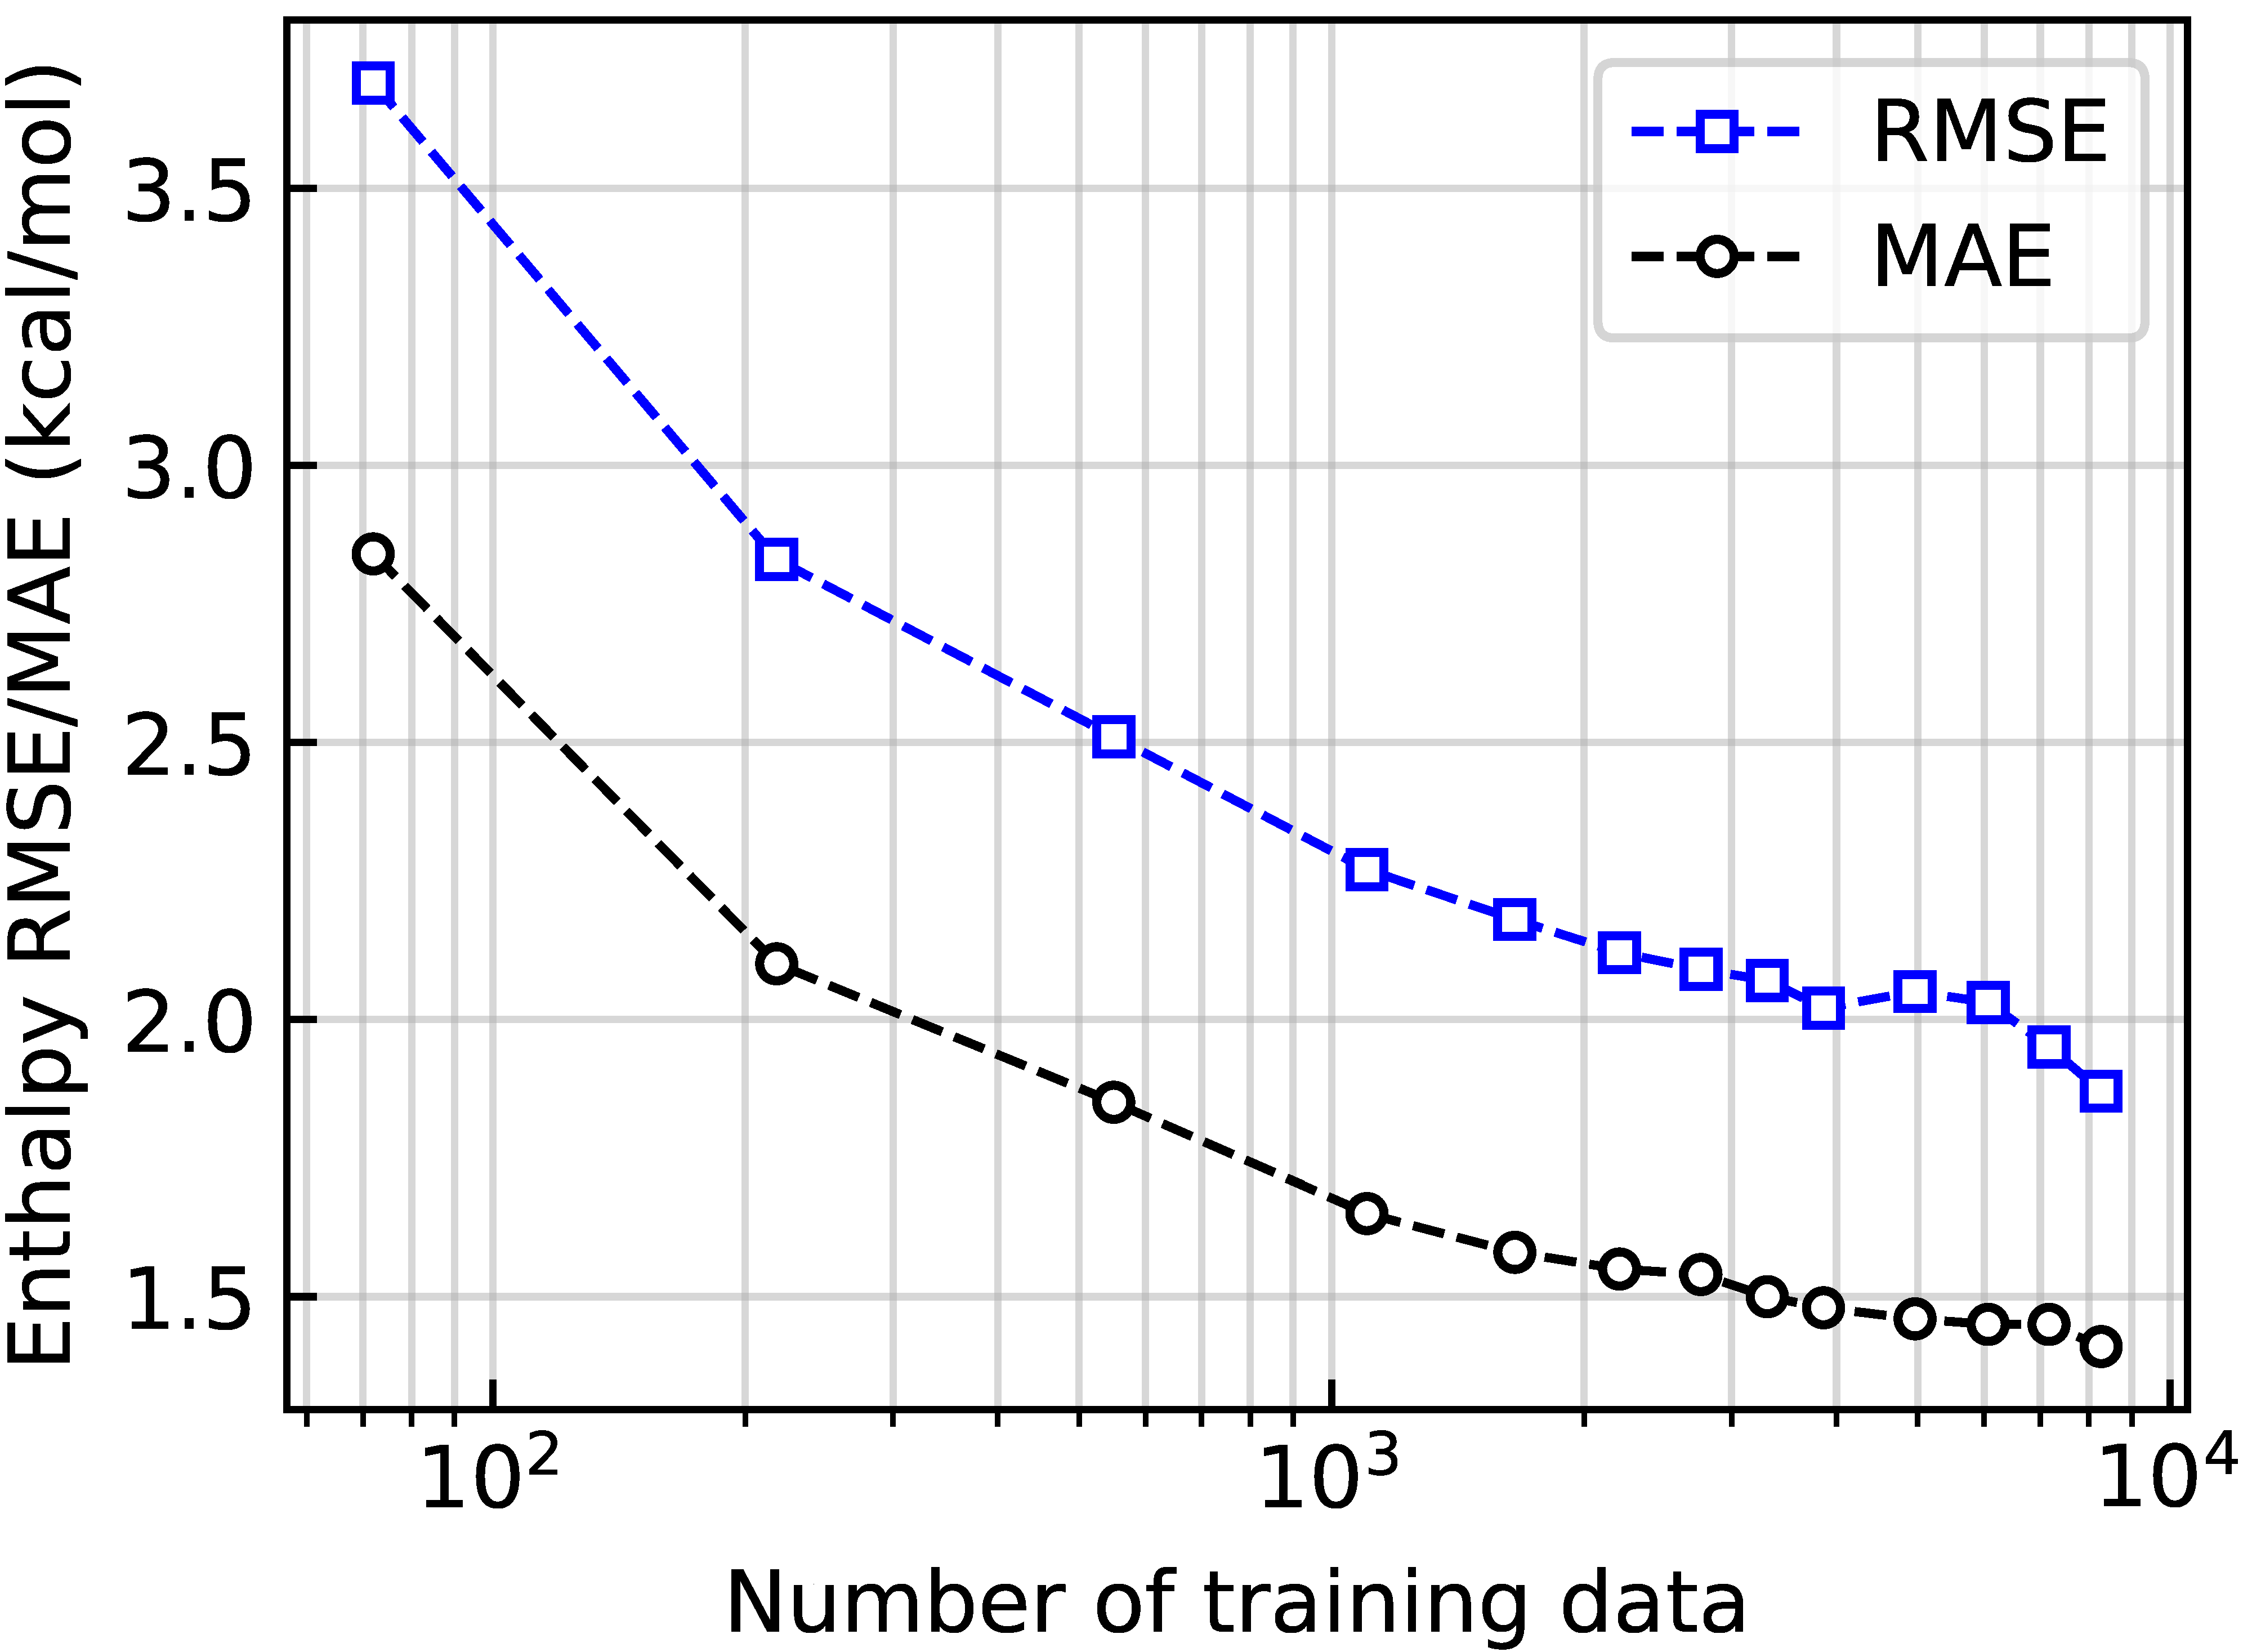
Transfer learning affords very accurate predictions with <10,000 data points

Slide 21
Overview
Background
Automated transition state algorithms
Improved thermochemistry estimation
Scalability of automated reaction discovery
?
4
3
8
5
6
2
1
9
7
8
1
2
3
4
5
7
9
6
?
?
NN
NN

Slide 22
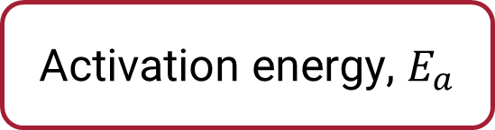
Machine learning can rapidly assess the importance of new reactions
NN
Important?
Important?
Activation energy, $E_{a}$

Slide 23
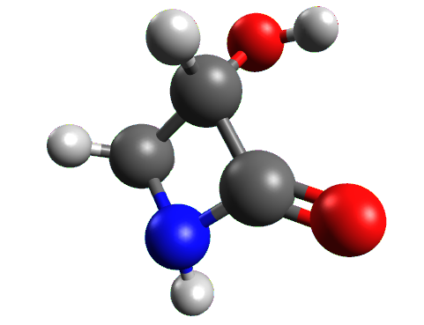
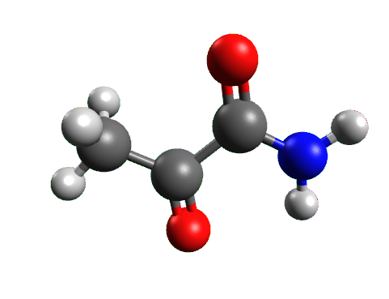
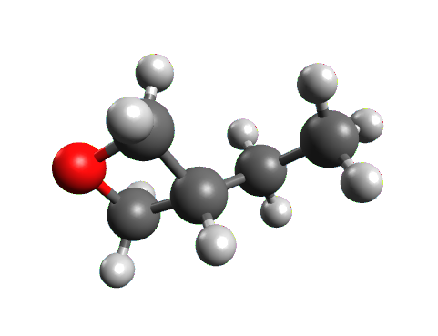
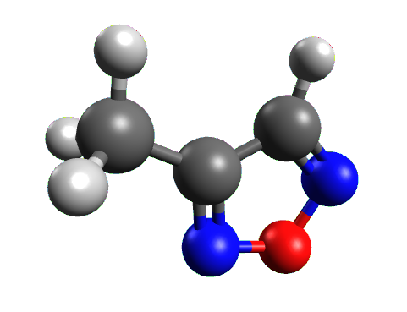
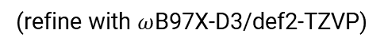
Automated discovery methods generate a reaction dataset
Optimize random selection of reactants
Search pathways (single-ended GSM)
(with B97-D3/def2-mSVP)
Optimize transition states and products
(refine with $ω$B97X-D3/def2-TZVP)
Encode as atom-mapped SMILES
[O:1]=[C:2]([N:3]([C:4]1([H:9])[C:5]([H:10])([H:11])[C:6]1([H:12])[H:13])[H:8])[H:7]
[O:1]([C:2](=[N:3][H:8])[H:7])[C:6]([C:4](=[C:5]([H:10])[H:11])[H:9])([H:12])[H:13]
activation_energy = x kcal/mol, reaction_enthalpy = y kcal/mol

Slide 24
Driving coordinate limits have to be set to ensure computational tractability
BREAK 3 4
BREAK 1 9
ADD 6 9
Grow and optimize paths with single-ended growing string method
BREAK 5 6
BREAK 3 4
BREAK 3 4
ADD 2 4
ADD 3 5
…
Specify driving coordinates subject to connectivity and complexity constraints
N_{BREAK} ≤ 2
N_{ADD} ≤ 2
N_{BREAK} + N_{ADD} ≤ 3
N_{non-H atoms} ≤ 7
HCNO only
Singlets only
Unimolecular
A
Uni-/multimolecular
B (+ C (+ …))

Slide 25
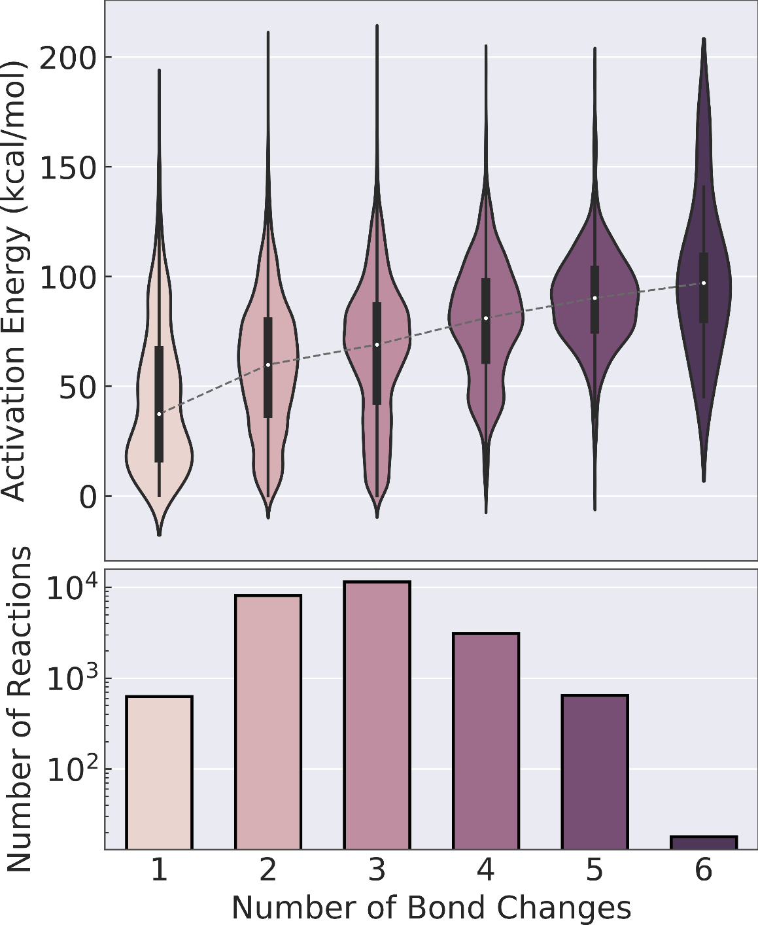
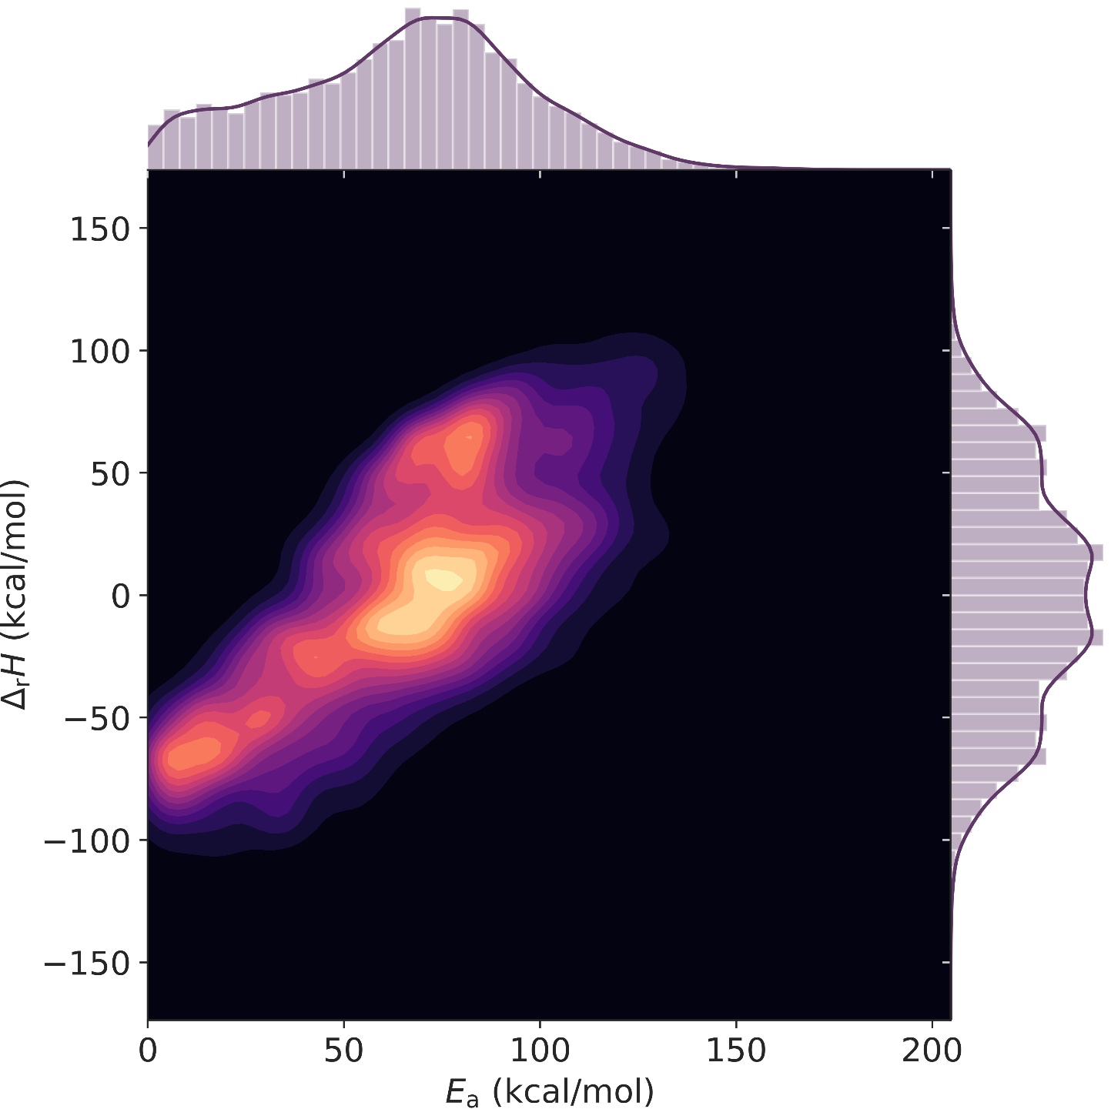
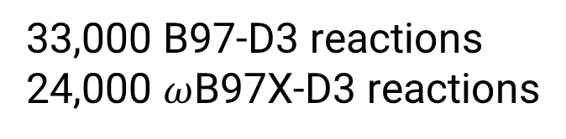
The generated reaction dataset spans a wide range of activation energies
33,000 B97-D3 reactions
24,000 $ω$B97X-D3 reactions

Slide 26
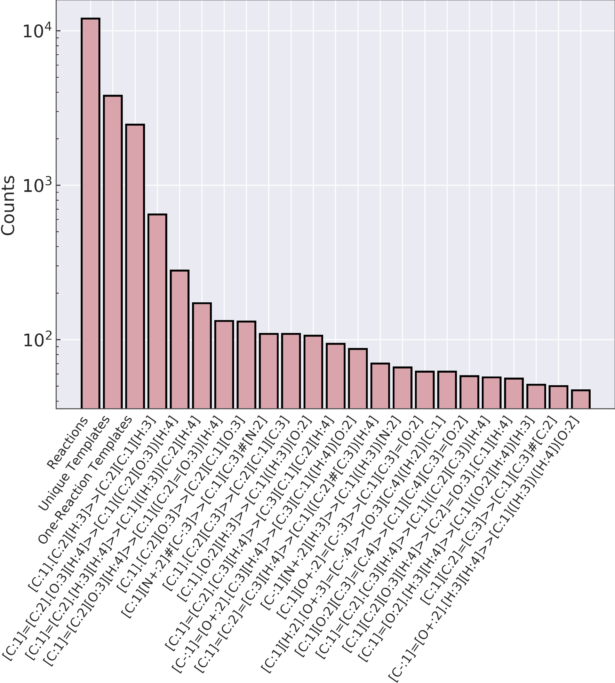
The generated reactions are very diverse
Extracted templates
Templates generated according to:
Only include atoms in reactive center
Only features are:
Atom identity
Bond order
Charge and aromaticity

Slide 27
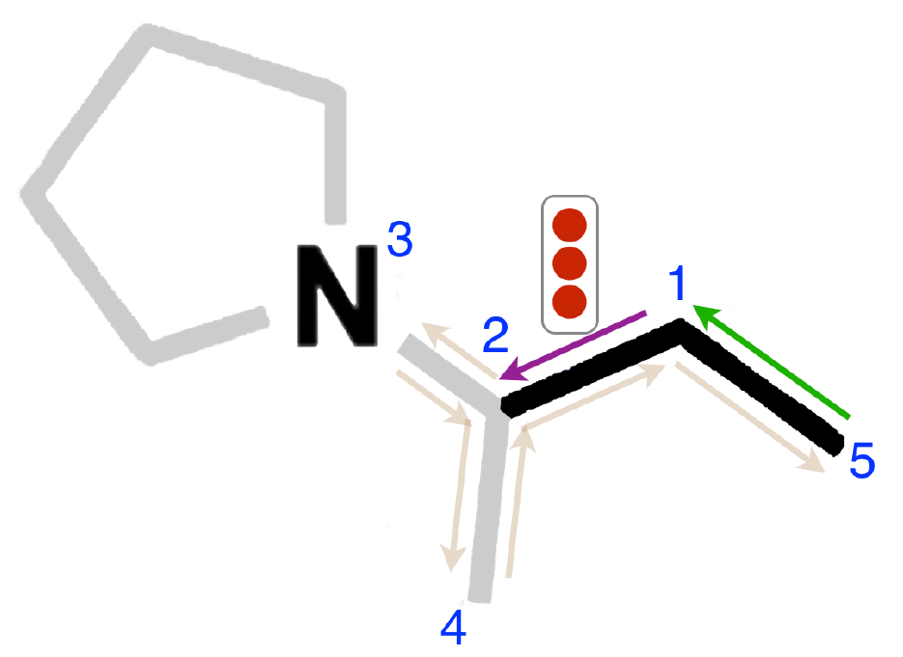
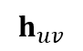
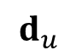







Difference network focuses predominantly on reactive centers and incorporates effects of neighboring atoms
4
3
8
5
2
1
9
$$h_{uv}$$
6
7
$$h_{u}$$
$$h_{v}$$
8
4
5
1
2
3
6
7
9
attributed reactant and product graphs
Graph convolution
$$h_{v}^{\left(P\right)}$$
$$d_{v}$$
$$d_{u}$$
NN
$$d_{v}$$
NN
$$E_{a}$$
$$h_{v}^{\left(R\right)}$$
difference features
embedded
reaction

Slide 28


Learned embeddings organize reaction space suitably
PCA on learned embeddings
PCA on Morgan fingerprints
reaction embedding
diffNN
Graph conv.
NN
$$E_{a}$$
ECFP (Morgan fingerprint):
Like graph convolution but with fixed hash function instead of neural network

Slide 29




Activation energies are predicted with low error
10-fold cross validation scaffold split test error:
1.706 $±$ 0.086 kcal/mol
High-error reactions

Slide 30






Atoms far from the reactive center do not contribute significantly to the activation energy prediction
$$h_{v}^{\left(P\right)}$$
$$d_{v}$$
$$\left\{\begin{aligned}≈0, v∉reactive center \\ >0, v∈reactive center\end{aligned}\right.$$
$$h_{v}^{\left(R\right)}$$
difference fingerprint
1
Reactive center
1
2
1
2
1
3
3

Slide 31

Activation energy model is more precise than RMG decision tree estimators
RMG reaction templates/families
R1-H + R2•
C-H + R2•
O-H + R2•
O-CH2-H
+ R2•
C-CH2-H
+ R2•
O-H + C•
O-H + O•
Template-based decision tree estimator

Slide 32



Summary and future work
Automated transition state algorithms
Improved thermochemistry estimation
Scalability of automated reaction discovery
?
4
3
8
5
6
2
1
9
7
8
1
2
3
4
5
7
9
6
?
NN
?
NN
Bimolecular and radical reactions
?
?
?
?

Slide 33
Radical and bimolecular reactions cannot yet be predicted accurately by the model
?
?
?
?

Slide 34




Acknowledgements
Thesis Committee
Prof. William H. Green
Prof. Heather J. Kulik
Prof. Bernhardt L. Trout
Prof. Klavs F. Jensen
Collaborators
Dr. Judit Zádor
Green Group
Lucky Pattanaik
Mark Payne
Max Liu
Matt Johnson
Dr. Alon Dana
Dr. Duminda Ranasinghe
Green Group Alumni
Prof. Yi-Pei Li
Dr. Kehang Han
Prof. Yury Suleimanov
Dr. Adeel Jamal
Dr. Connor Coley
Dr. Phalgun Lolur
Funding

Slide 35
Additional Slides

Slide 36


New reaction of Criegee with vinyl alcohol could be relevant at atmospheric conditions
Pressure-dependent well-skipping
is important
Competitive with

Slide 37

Transfer learning data

Slide 38



Bond additivity corrections provide high-quality training data
$$Δ_{f}^{BAC}H_{298}^{∘}=Δ_{f}H_{298}^{∘}−\sum_{i∈atoms}{α_{i}}−\sum_{ij∈bonds}{E_{BAC,ij}}$$
$$E_{BAC,ij}=\sqrt{β_{i}β_{j}}e^{−ξR_{ij}}+\sum_{k∈neighbors(i)}{\left[γ_{k}+γ_{i}\right]}$$
$$+\sum_{ℓ∈neighbors(j)}{\left[γ_{ℓ}+γ_{j}\right]}$$
MAE after fitting: < 1 kcal/mol

Slide 39

















Neural networks are well-suited for learning highly nonlinear problems with abundant training data
$$w_{ij}^{\left(1\right)}$$
$$h_{j}=τ\left(\sum_{i}{w_{ij}^{\left(1\right)}x_{i}}\right) h=τ\left(W_{1}x\right)$$
$$h_{1}$$
$$x_{1}$$
$$w_{i}^{\left(2\right)}$$
$$h_{2}$$
$$τ\left(z\right)=ReLU\left(z\right)=\max\left(0,z\right)$$
$$x_{2}$$
$$h_{3}$$
$$y$$
$$y=\sum_{i}{w_{i}^{\left(2\right)}h_{i}}=w_{2}^{T}h$$
$$x_{3}$$
$$h_{4}$$
$$x_{4}$$
$$h_{5}$$
$$\min_{W_{1},w_{2}}{ \frac{1}{n}\sum_{i=1}^{n}{{\left(y_{i}^{model}−y_{i}^{true}\right)}^{2}}}$$
$$h_{6}$$
Training neural nets is just learning parameter matrices ($W_{1}$, $w_{2}$)

Slide 40


Message passing neural network for chemical reactions
$$h_{vw}^{0}=τ\left(W_{i} cat\left(x_{v},e_{vw}\right)\right)$$
$$m_{vw}^{t+1}=\sum_{k∈\left\{N\left(v\right)\backslash w\right\}}{h_{kv}^{t}}$$
$$h_{vw}^{t+1}=τ\left(h_{vw}^{0}+W_{m}m_{vw}^{t+1}\right)$$
$$m_{v}=\sum_{w∈N\left(v\right)}{h_{vw}^{T}}$$
$$h_{v}=τ\left(W_{a} cat\left(x_{v}, m_{v}\right)\right)$$
$$d_{v}=τ\left(W_{d}\left(h_{v}^{\left(P\right)}−h_{v}^{\left(R\right)}\right)\right)$$
$$r=\sum_{v∈G}{d_{v}}$$
$$E_{a}=w^{T}r$$
$G_{R}$, $G_{P}$: reactant and product graphs
$x_{v}$, $e_{vw}$: atom and bond features
$h_{vw}$, $m_{vw}$: hidden state and message of bond $vw$
$h_{v}$, $m_{v}$: hidden state and message of atom $v$
$τ$: ReLU activation function
$W_{i}$, $W_{m}$, $W_{a}$, $W_{d}$, $w$: Learnable parameter matrices

Slide 41

3-heavy-atom reactions are difficult to model
H₂

Slide 42



Modeling lubricant degradation is extremely complex
Small molecule, high-$T$ modeling is well-established
Liquid-phase oxidation:
Many species/reactions require many rate and equilibrium constant estimates
Low $T$: sensitive to $E_{a}$ errors
Solvation effects
Vaporization
Vaporization
Fresh lubricant
Degradation
Dispersion
Micelles/ complexes
Polar precursors
Insolubles drop out/adsorption to metal
Re-dispersion
Adsorption
Formed via cyclization/
dehydrogenation
“Soft” deposit
Formed via polymerization
“Hard” deposit
Degradation on metal surface

Slide 43


Previous work shows reasonable agreement between RMG predictions and experiments at ExxonMobil
Decylcyclohexane degradation
Predicted
Measurement

Slide 44
Literature search can uncover missing reaction families

Slide 45





Literature yields useful new chemistry

Slide 46

New decylcylohexane model shows very diverse chemistry
869 species
239,683 reactions
Dihydroperoxides
Mono- hydroperoxides
Cyclic ethers, other oxidation products, and smaller carbon chains
Trihydroperoxides

Slide 47





More resolution into product distribution is needed to determine model agreement with experiment
Experiment
RMG model
1+
321.228
Trihydroperoxides

